Slide 1
Technology, Screen Time, and Their Effects on Mental Health
Nisa Kan 31999

Slide 2
MY DATASET
User_ID: Anonymized unique identifier
Age & Gender: Demographic information
Technology_Usage_Hours: Daily time spent using digital devices
Social_Media_Usage_Hours: Hours spent specifically on social media
Gaming_Hours: Time spent playing games on a daily basis
Screen_Time_Hours: Total screen exposure per day
Sleep_Hours: Daily sleep duration in hours
Stress_Level: Self-reported (Low, Medium, High) → converted to numerical scale (1–3)
Mental_Health_Status: General mental well-being status (e.g., stable, moderate, struggling)
Physical_Activity_Hours: Exercise or active hours per day
Support_Systems_Access: Whether the individual has access to emotional or social support
Work_Environment_Impact: How work setting affects stress (e.g., high-pressure, balanced)
Online_Support_Usage: Use of digital tools or communities for mental support

Slide 3
Hypotheses
Null Hypothesis (H₀):
There is no significant relationship between screen time and stress or sleep duration.
Alternative Hypothesis (H₁):
Screen time significantly impacts stress levels and sleep quality.

Slide 4
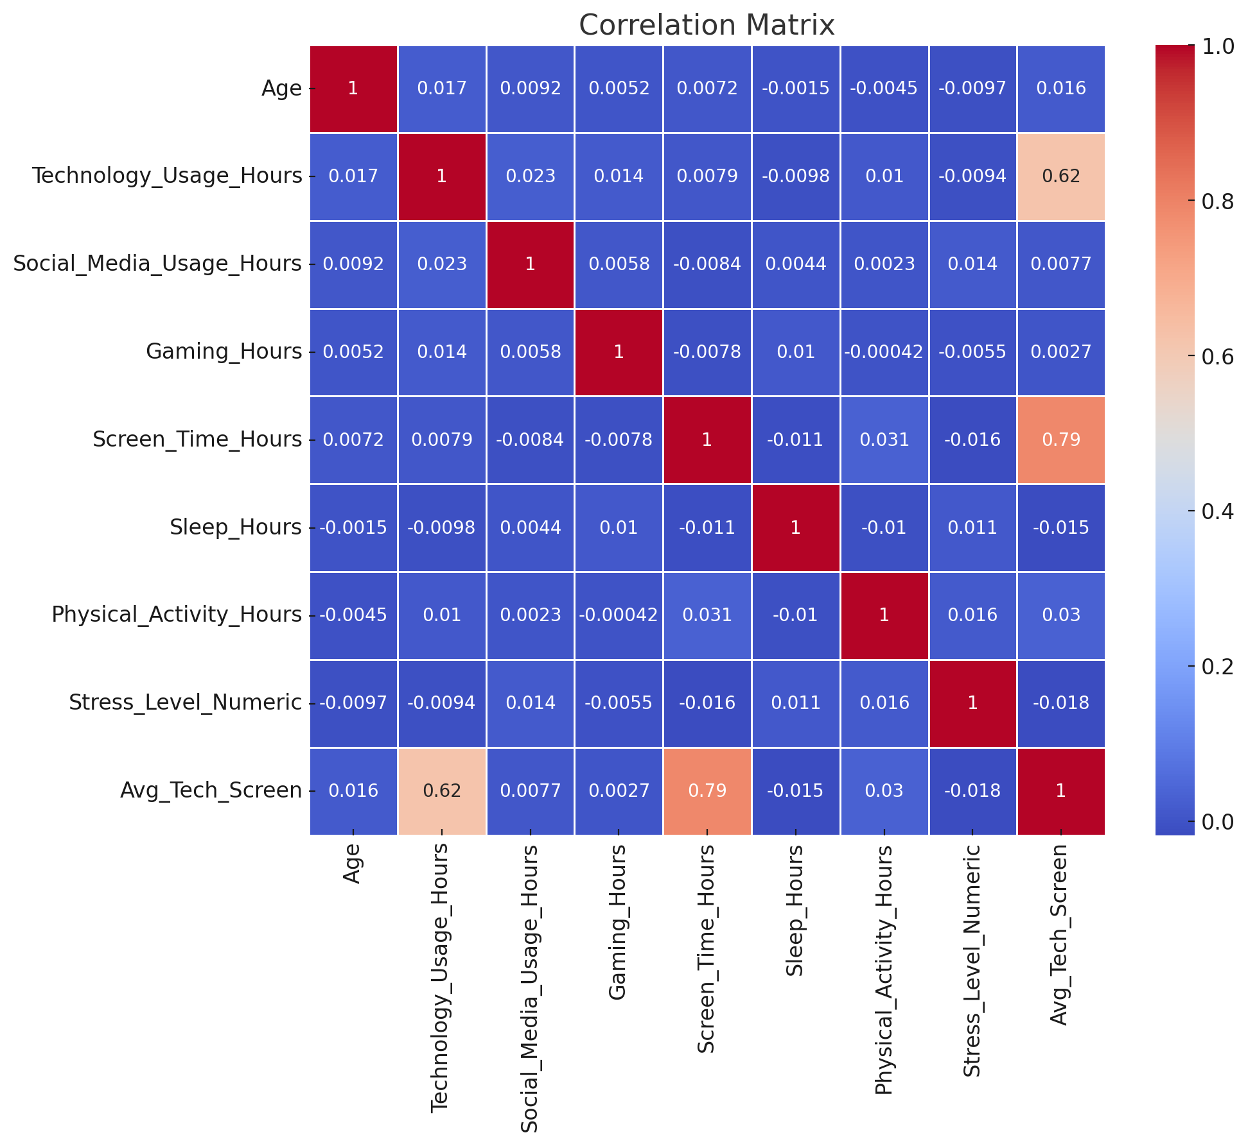
CorrelatIon Heatmap
-There is little to no strong linear correlation between screen time, technology usage, and sleep hours. However, slight negative associations are visible between screen time and sleep.

Slide 5
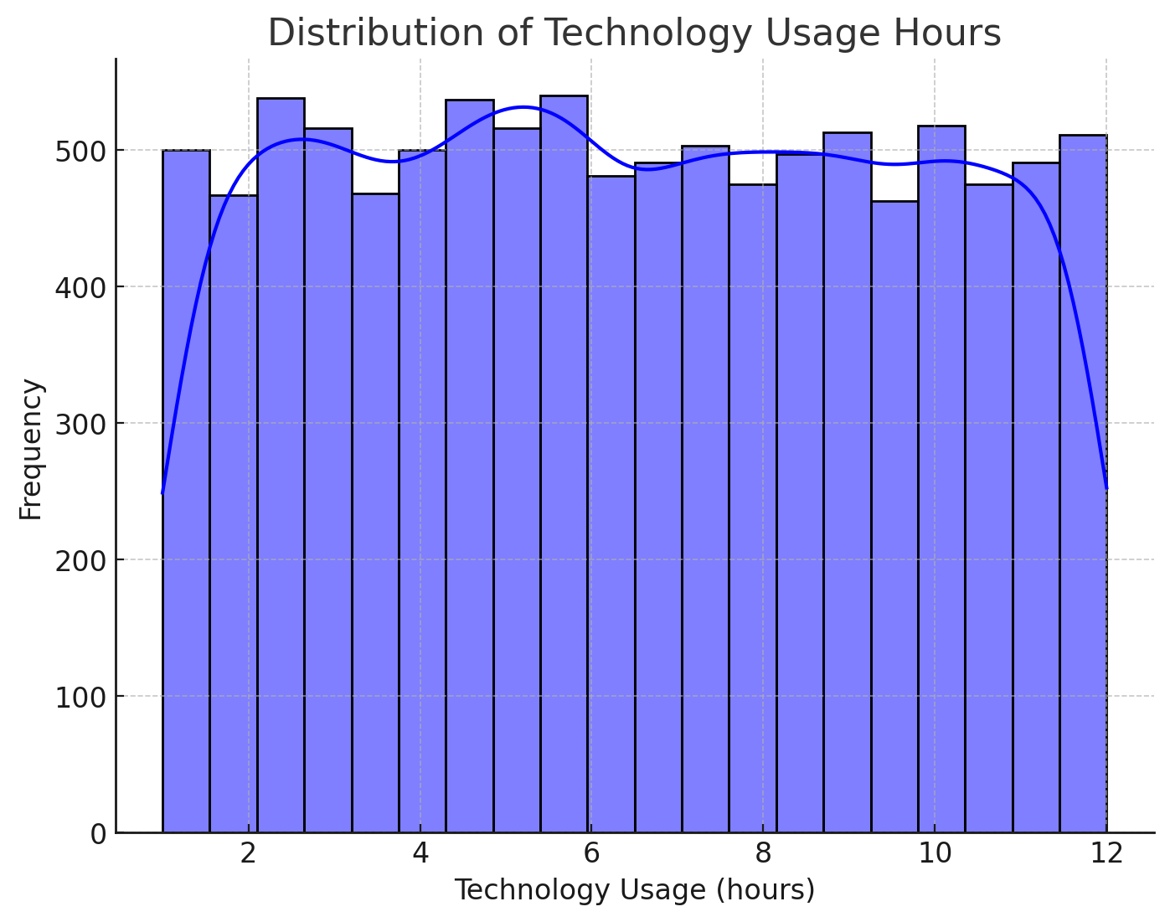
Technology Usage HIstogram
-Most individuals use technology for about 2 to 6 hours daily, with a right-skewed distribution showing some heavy users above 8 hours.

Slide 6
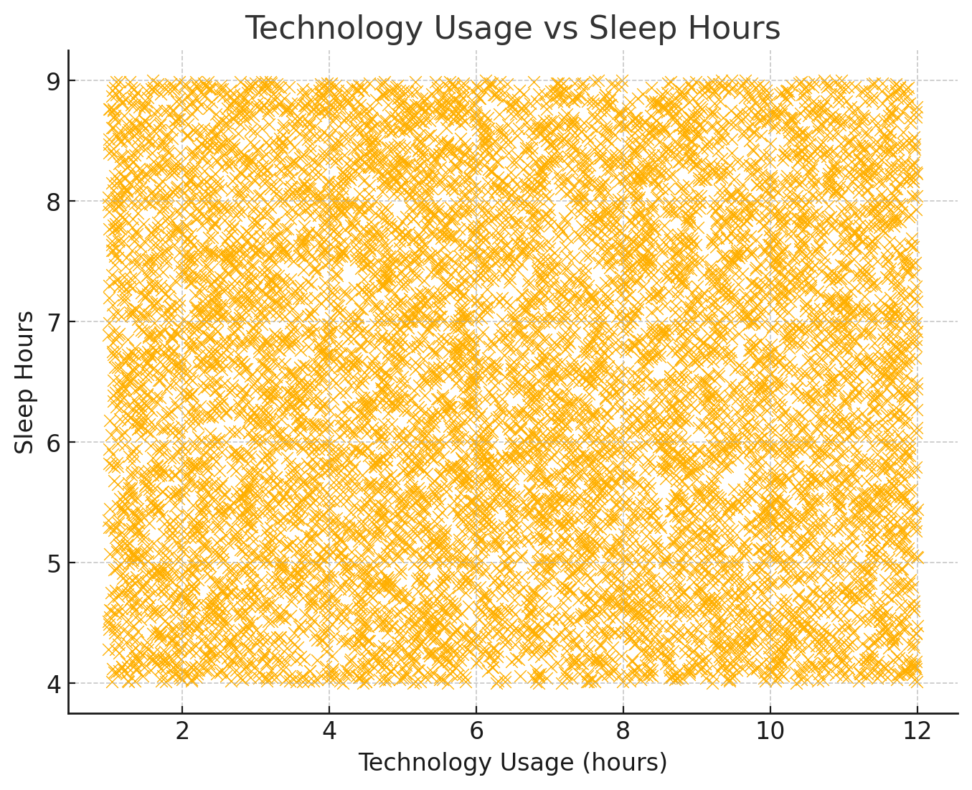
Technology Usage vs Sleep Hours
-Here is no clear trend, but a weak negative pattern suggests that higher technology usage may slightly reduce sleep duration

Slide 7
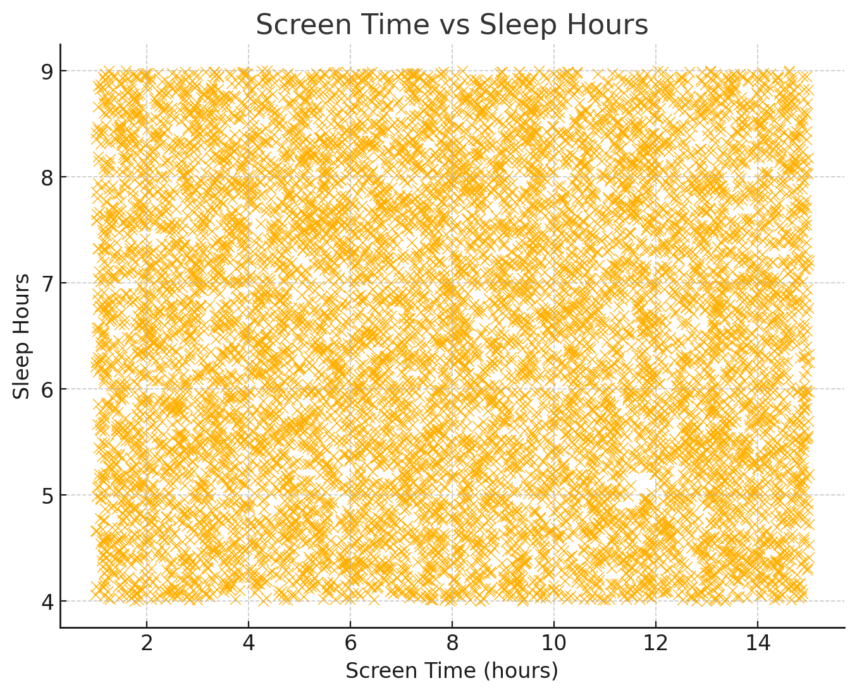
Screen TIme vs Sleep Hours
-Similar to technology use, screen time appears to be mildly inversely related to sleep hours, though not strongly enough to be statistically significant.

Slide 8
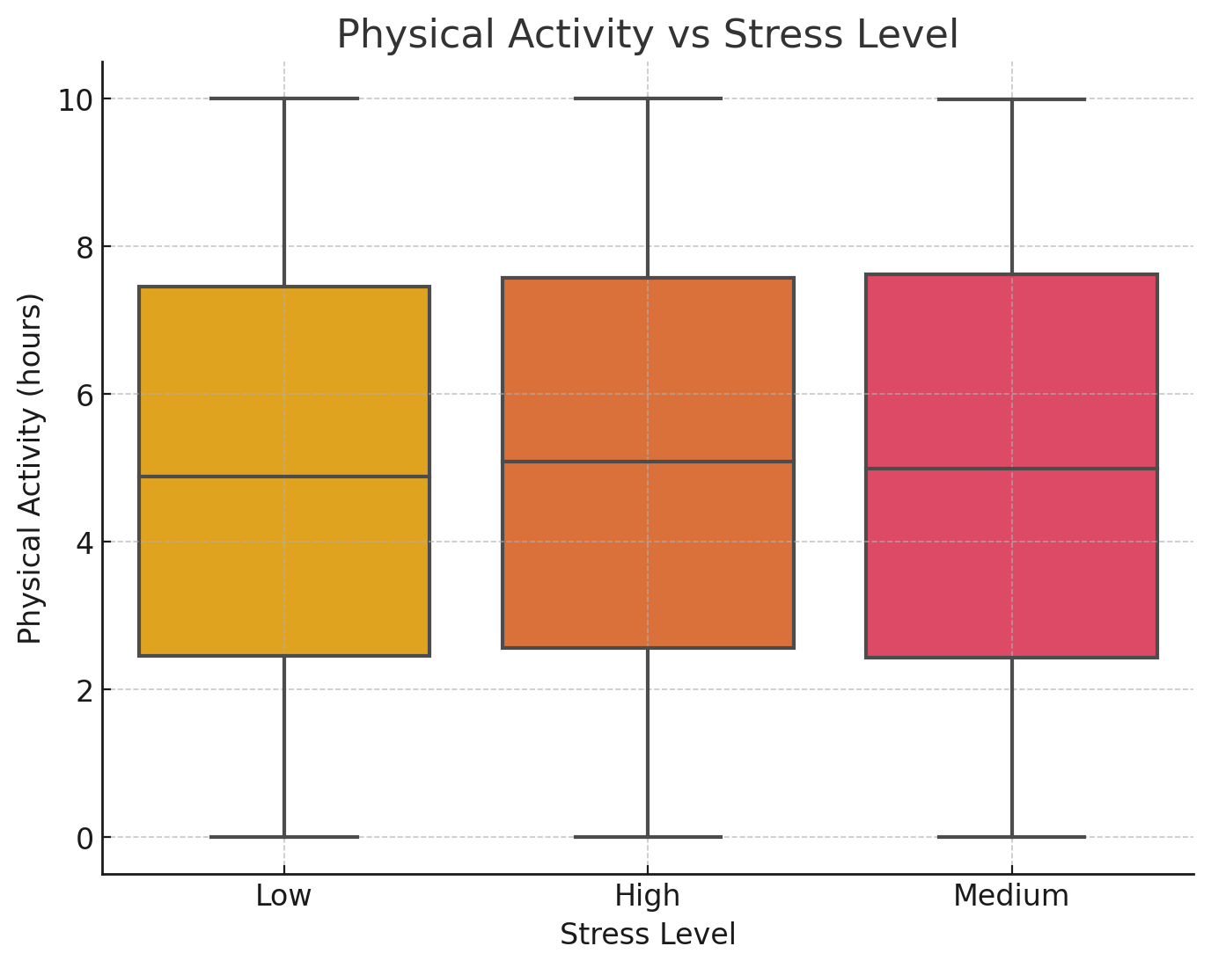
PhysIcal ActIvIty vs Stress Level
-Individuals with lower stress levels tend to report higher levels of physical activity, while highly stressed individuals show lower activity ranges.

Slide 9
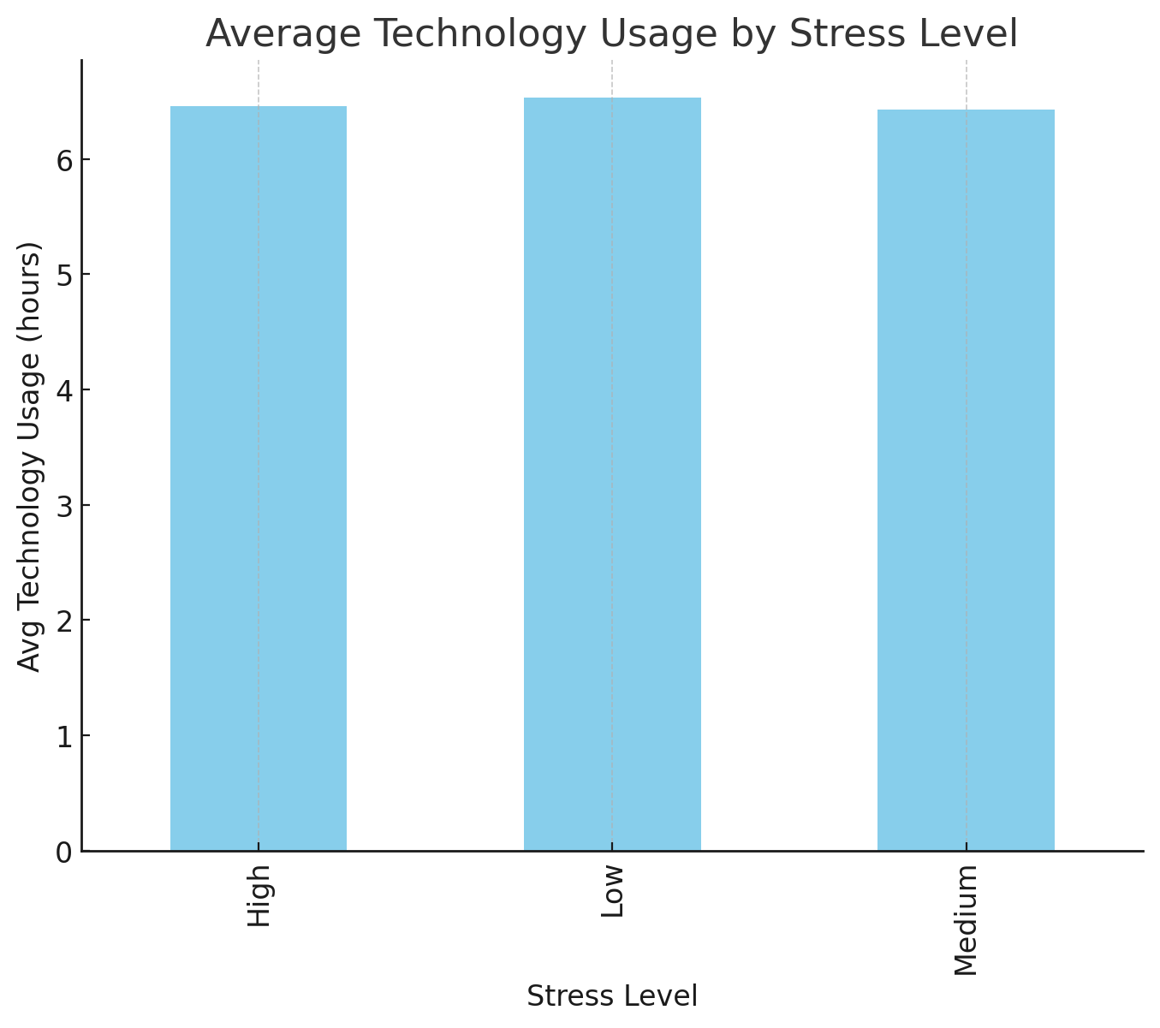
Average Tech Usage by Stress Level
-Users reporting medium stress levels tend to have the highest average technology usage, while those with high stress tend to use technology less.

Slide 10
CONCLUSION
We fail to reject the null hypothesis as the p-values are > 0.05. There is no statistically significant relationship between screen time and sleep duration. However, trends show that excessive screen time and low physical activity may be linked to higher stress levels.

